Slide 1
Lecture 11
Question Answering
(Based on: Rada Mihalcea’s coursware, some of his slides were adapted from Chris Manning’s IR course, who in turn borrowed them from Nicholas Kushmerick, ISI)

Slide 2
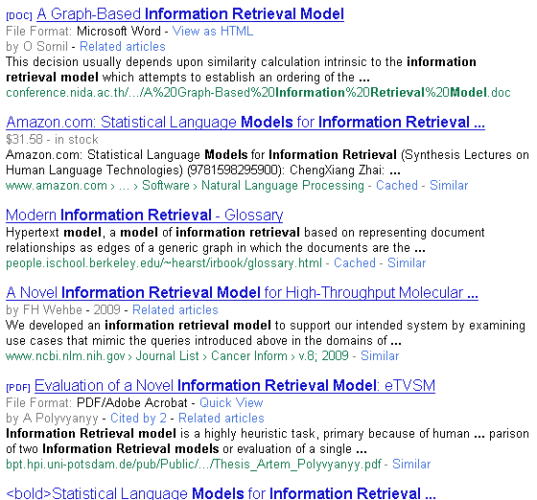
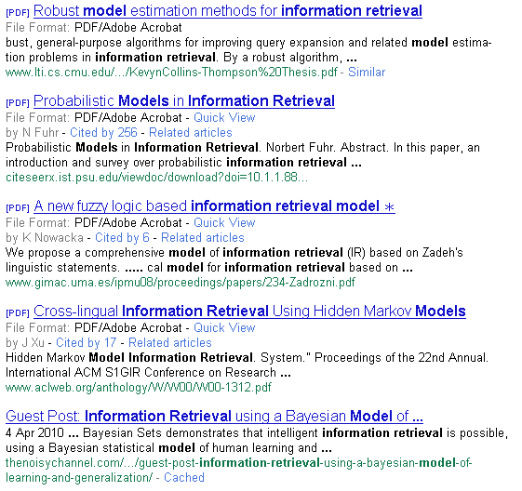
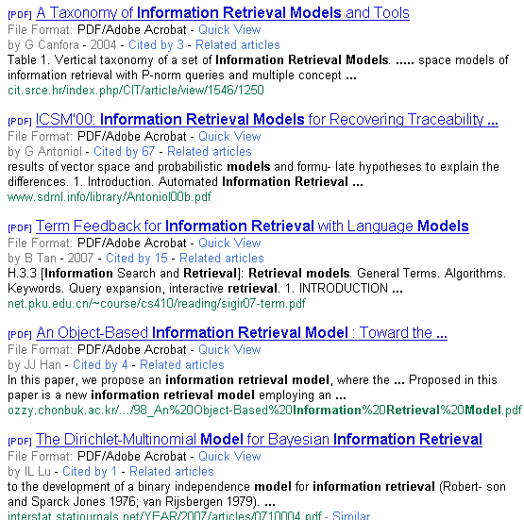
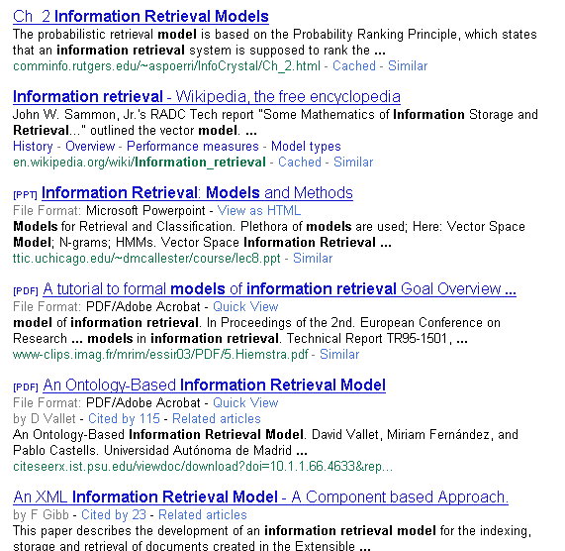

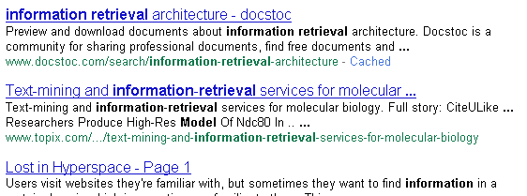

Background
Example. do the search via Google

Slide 3
Question Answering from text
An idea originating from the IR community
With massive collections of full-text documents, simply finding relevant documents is of limited use: we want answers from textbases
QA: give the user a (short) answer to their question, perhaps supported by evidence.
The common person’s view? [From a novel]
“I like the Internet. Really, I do. Any time I need a piece of shareware or I want to find out the weather in Bogota … I’m the first guy to get the modem humming. But as a source of information, it sucks. You got a billion pieces of data, struggling to be heard and seen and downloaded, and anything I want to know seems to get trampled underfoot in the crowd.”
M. Marshall. The Straw Men. HarperCollins Publishers, 2002.
Notes:
Of course it is a difficult area to evaluate the performance of systems as different people have different ideas as to what constitutes an answer, especially if the systems are trying to return exact answers.

Slide 4
People want to ask questions…
Examples from AltaVista query log
who invented surf music?
how to make stink bombs
where are the snowdens of yesteryear?
which english translation of the bible is used in official catholic liturgies?
how to do clayart
how to copy psx
how tall is the sears tower?
Examples from Excite query log (12/1999)
how can i find someone in texas
where can i find information on puritan religion?
what are the 7 wonders of the world
how can i eliminate stress
What vacuum cleaner does Consumers Guide recommend
Around 12–15% of query logs

Slide 5
The Google answer #1
Include question words etc. in your stop-list
Do standard IR
Sometimes this (sort of) works:
Question: Who was the first chairman of People's republic of China?
Answer: Mao Zedong.
Notes:
Extract keywords from question, then run the search

Slide 6
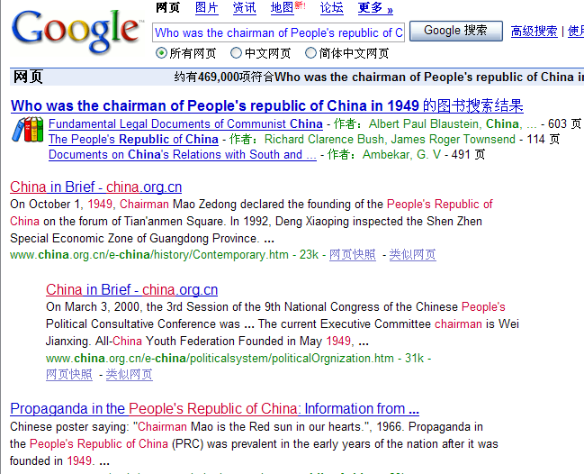
Page about the founding of PRC
(Can deduce answer)
Page about propaganda in China
(Can deduce answer)

Slide 7
But often it doesn’t…
Question: How much money did IBM spend on advertising in 2006?
Answer: I dunno, but I’d like to … ☹

Slide 8
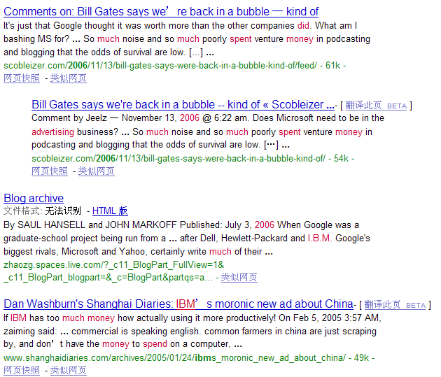
It’s even not about IBM!
No relevant info
Seems closing to answer?

Slide 9
The Google answer #2
Take the question and try to find it as a string on the web
Return the next sentence on that web page as the answer
Works brilliantly if this exact question appears as a FAQ question, etc.
Works lousily most of the time
Remind of the line about monkeys and typewriters producing Shakespeare
But a slightly more sophisticated version of this approach has been revived with considerable success…
Notes:
Run the exact string match and hope that someone had asked the same question and got answer on the web.

Slide 10
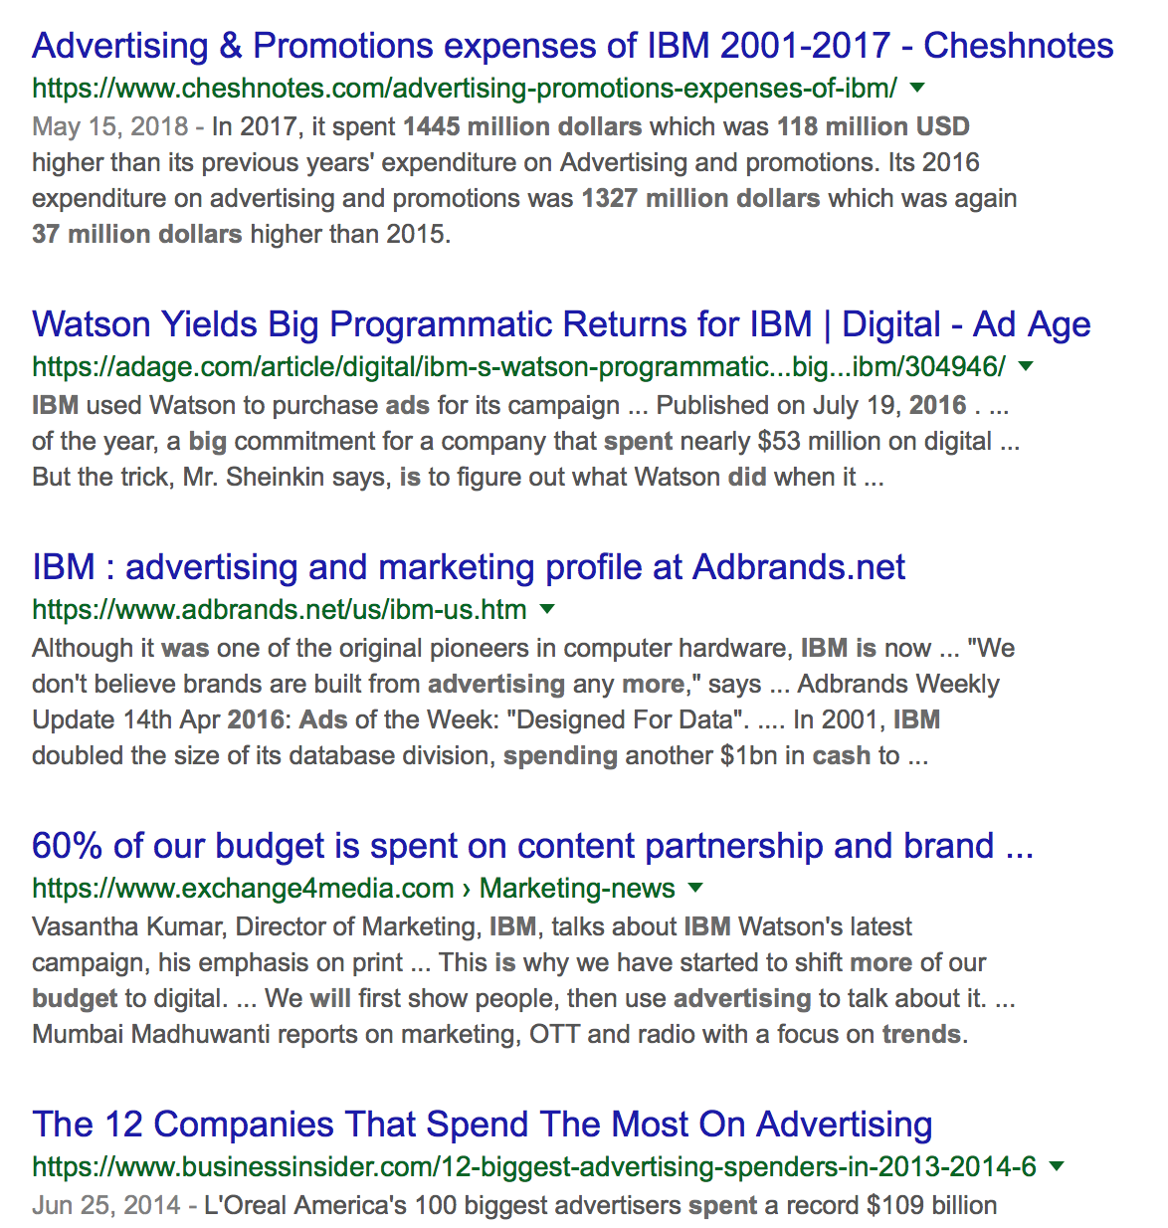
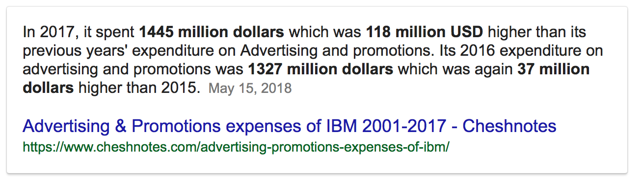
Question: How much money did IBM spend on advertising in 2016?
Get closing to answer
Lucky?
Still a lot of noise

Slide 11
A Brief (Academic) History
In some sense question answering is not a new research area
Question answering systems can be found in many areas of NLP research, including:
Natural language database systems
A lot of early NLP work on these
Spoken dialog systems
Currently very active and commercially relevant
The focus on open-domain QA is still challenging
MURAX (Kupiec 1993): Encyclopedia answers
Hirschman: Reading comprehension tests
TREC QA competition: 1999–
Question types:
Factoid Question Answering 事实陈述问答
List Question Answering 列表问答
Definition Question Answering定义问答
Notes:
Obviously question answering is an important technology that appears in other areas as well as those outlined here. The ones mentioned here are those that are significant and are almost entirely QA dependent rather than use QA as an additional technology.

Slide 12


Online QA Examples
Examples
Baidu Knows: http://zhidao.baidu.com/
“知识”: http//ks.cn.yahoo.com/
AnswerLogic, AnswerFriend, Start, Quasm, Mulder, Webclopedia, etc.
Microsoft Xiaoice
Apple Siri, IBM Waston

Slide 13
Question Answering at TREC
Question answering competition at TREC consists of answering a set of 500 fact-based questions, e.g., “When was Mozart born?”.
For the first three years systems were allowed to return 5 ranked answer snippets (50/250 bytes) to each question.
IR think
Mean Reciprocal Rank (MRR) scoring:
1, 0.5, 0.33, 0.25, 0.2, 0 for 1, 2, 3, 4, 5, 6+ doc
Mainly Named Entity answers (person, place, date, …)
From 2002 the systems are only allowed to return a single exact answer and the notion of confidence has been introduced.
Notes:
Mozart was born in 1756.
The reason for wanting only exact answers to be returned, is to get systems to accurately pinpoint the answer within the text. Systems can then provide as much context as the user requests, but to return context you need to know the extent of the answer within the text, i.e. exactly what piece of text constitutes just the answer and nothing else.

Slide 14
Sample TREC questions
1. Who is the author of the book, "The Iron Lady: A
Biography of Margaret Thatcher"?
2. What was the monetary value of the Nobel Peace
Prize in 2001?
3. What does the Peugeot company manufacture?
4. How much did Mercury spend on advertising in 1993?
5. What is the name of the managing director of Apricot
Computer?
6. Why did David Koresh ask the FBI for a word processor?
7. What debts did Qintex group leave?
8. What is the name of the rare neurological disease with
symptoms such as: involuntary movements (tics), swearing,
and incoherent vocalizations (grunts, shouts, etc.)?

Slide 15
Top Performing Systems
The best performing systems at TREC can answer approximately 70% of the questions
Approaches and successes have varied a fair deal
Knowledge-rich approaches, using a vast array of NLP techniques stole the show in 2000, 2001
AskMSR system stressed how much could be achieved by very simple methods with enough text (and now various copycats)
Middle ground is to use large collection of surface matching patterns (ISI)

Slide 16
Sample TREC questions
TREC 2016 Live QA question:
<question number="5003">
Why does my cats behavior change so diradticly at night? So I have two litter mate cats, over one year old and have been neutered for more than six months. one of the cats has the same attitude all day and just gets more lovey at night. The other one is super cute and friendly during the day, and loves attention from me. But when night rolls around and I m about to get ready for bed, he avoids my touch. Walks away when I walk up and even one time when I picked him up, he hissed at me. It s not like he s mad at me for going to bed Bc he doesn t do this to my mother or sister. The other thing he does is when his brother is sleeping with me, he ll come in, wake him up, and then leave my room with his brother following him. Does anything describe this behavior? Why does this happen?
</question>
<question number="5218"> <question> Question: Why does all of my power go out in my house when i turn on the air conditioner? How does this get fixed? </question>

Slide 17
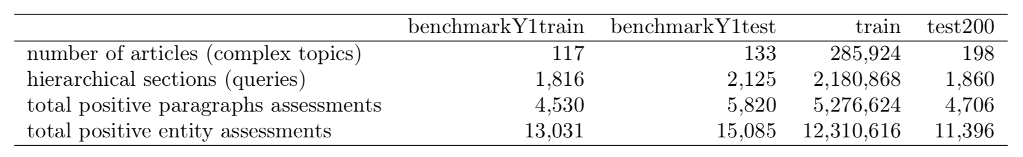
TREC 2017 CAR-Complicate Answer Retrieval
Passage Task: Given an outline for complex topic outline Q, retrieve for each of its sections Hi, a ranking of relevant passages S.
Entity Task: Given outline for complex topic Q, retrieve for each of its sections Hi, a ranking of relevant entities E and with support passages S. These support passage should motivate the why the entity is relevant for the query.

Slide 18
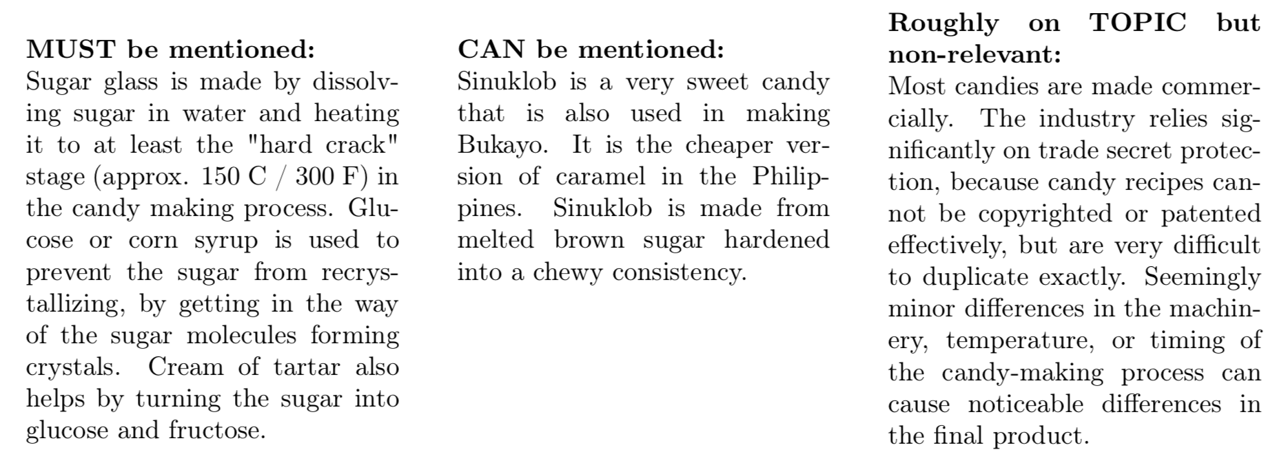
TREC 2017 CAR-Complicate Answer Retrieval
E.g. query: “Candy Making / Hard Candy ”

Slide 19
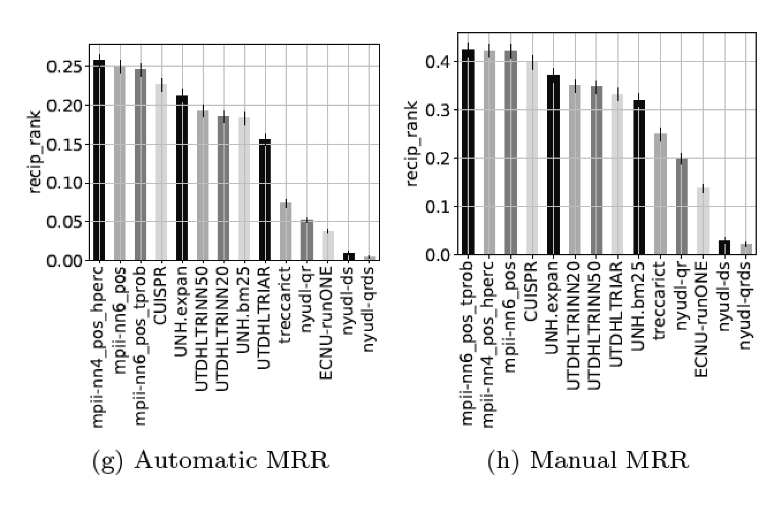
TREC 2017 CAR-Complicate Answer Retrieval

Slide 20
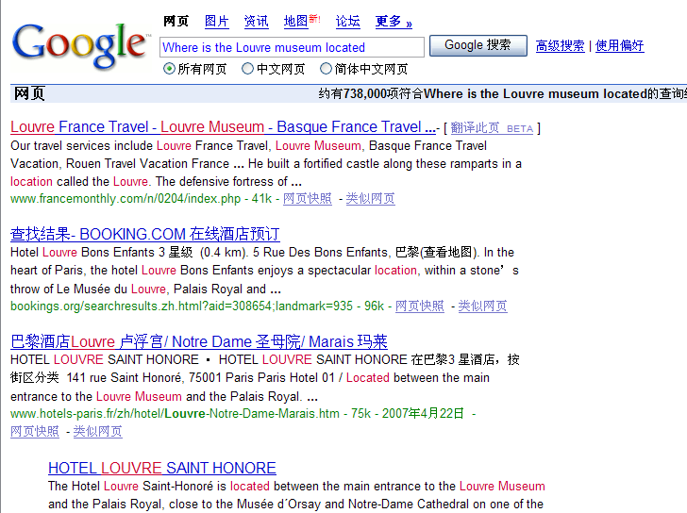
AskMSR
Web Question Answering: Is More Always Better?
Dumais, Banko, Brill, Lin, Ng (Microsoft, MIT, Berkeley)
Q: “Where is the Louvre museum located?”
Want “Paris” or “France” or “75058 Paris Cedex 01” or a map
Don’t just want URLs

Slide 21
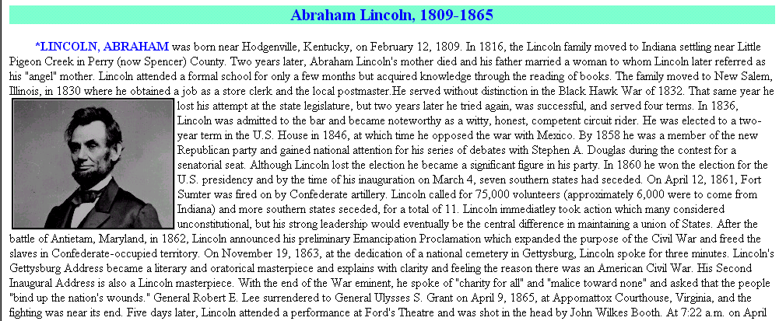
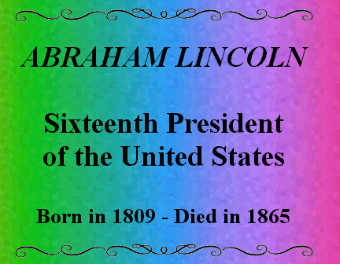
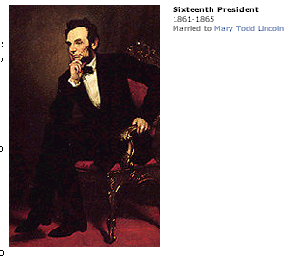
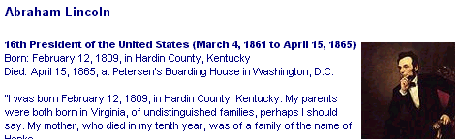
AskMSR: Shallow approach
In what year did Abraham Lincoln die?
Ignore hard documents and find easy ones

Slide 22
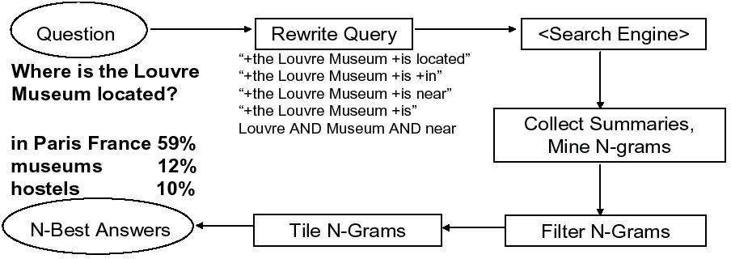
AskMSR: Details
1
2
3
5
4

Slide 23
Step 1: Rewrite queries
Intuition: The user’s question is often syntactically quite close to sentences that contain the answer
Where is the Louvre Museum located?
The Louvre Museum is located in Paris
Who created the character of Scrooge?
Charles Dickens created the character of Scrooge.

Slide 24
Query rewriting
Classify question into seven categories
Who is/was/are/were…?
When is/did/will/are/were …?
Where is/are/were …?
a. Category-specific transformation rules
eg “For Where questions, move ‘is’ to all possible locations”
“Where is the Louvre Museum located”
→ “is the Louvre Museum located”
→ “the is Louvre Museum located”
→ “the Louvre is Museum located”
→ “the Louvre Museum is located”
→ “the Louvre Museum located is”
b. Expected answer “Datatype” (eg, Date, Person, Location, …)
When was the French Revolution? → DATE
Hand-crafted classification/rewrite/datatype rules (Could they be automatically learned?)
Nonsense, but who cares? It’s
only a few more queries to Google.

Slide 25
Query Rewriting - weights
Some query rewrites are more reliable than others
Where is the Louvre Museum located?
Weight 5 if we get a match, it’s probably right
Weight 1
Lots of non-answers could come back too
+“the Louvre Museum is located”
+Louvre +Museum +located

Slide 26
Step 2: Query search engine
Send all rewrites to a Web search engine
Retrieve top N answers (100?)
For speed, rely just on search engine’s “snippets”, not the full text of the actual document

Slide 27
Step 3: Mining N-Grams
Unigram, bigram, trigram, … N-gram: list of N adjacent terms in a sequence
Eg, “Web Question Answering: Is More Always Better”
Unigrams: Web, Question, Answering, Is, More, Always, Better
Bigrams: Web Question, Question Answering, Answering Is, Is More, More Always, Always Better
Trigrams: Web Question Answering, Question Answering Is, Answering Is More, Is More Always, More Always Betters
How can we use this n-grams to find out the right answer?

Slide 28
Mining N-Grams
Simple: Enumerate all N-grams (N=1,2,3 say) in all retrieved snippets
Use hash table and other fancy footwork to make this efficient
Weight of an n-gram: occurrence count, each weighted by “reliability” (weight) of rewrite that fetched the document
Example: “Who created the character of Scrooge?”
Dickens - 117
Christmas Carol - 78
Charles Dickens - 75
Disney - 72
Carl Banks - 54
A Christmas - 41
Christmas Carol - 45
Uncle - 31
How can we make sure that the high weighted n-grams match the type of expected answers?

Slide 29
Step 4: Filtering N-Grams
Each question type is associated with one or more “data-type filters” = regular expression
When…
Where…
What …
Who …
Boost score of n-grams that do match regexp
Lower score of n-grams that don’t match regexp
Date
Location
Person

Slide 30
Step 5: Tiling the Answers
Scores
20
15
10
merged, discard old n-grams
Charles Dickens
Dickens
Mr Charles
Score 45
Mr Charles Dickens
N-Grams
tile highest-scoring n-gram
N-Grams
Repeat, until no more overlap

Slide 31
Results
Standard TREC contest test-bed: ~1M documents; 900 questions
Technique doesn’t do too well (though would have placed in top 9 of ~30 participants!)
MRR = 0.262 (ie, right answered ranked about #4-#5)
Why? Because it relies on the enormity of the Web!
Using the Web as a whole, not just TREC’s 1M documents… MRR = 0.42 (ie, on average, right answer is ranked about #2-#3)

Slide 32
Issues
In many scenarios (e.g., monitoring an individuals email…) we only have a small set of documents
Works best/only for “Trivial Pursuit”-style fact-based questions
Limited/brittle for
question categories
answer data types/filters
query rewriting rules

Slide 33
ISI: Surface patterns approach
Use of Characteristic Phrases
"When was <person> born”
Typical answers
"Mozart was born in 1756.”
"Gandhi (1869-1948)...”
Suggests phrases like
"<NAME> was born in <BIRTHDATE>”
"<NAME> ( <BIRTHDATE>-”
as Regular Expressions can help locate correct answer

Slide 34
Use Pattern Learning
Example:
“The great composer Mozart (1756-1791) achieved fame at a young age”
“Mozart (1756-1791) was a genius”
“The whole world would always be indebted to the great music of Mozart (1756-1791)”
Longest matching substring for all 3 sentences is "Mozart (1756-1791)”
Suffix tree would extract "Mozart (1756-1791)" as an output, with score of 3
Reminiscent of IE (Information Extraction) pattern learning

Slide 35
Pattern Learning (cont.)
Repeat with different examples of same question type
“Gandhi 1869”, “Newton 1642”, etc.
Some patterns learned for BIRTHDATE
a. born in <ANSWER>, <NAME>
b. <NAME> was born on <ANSWER> ,
c. <NAME> ( <ANSWER> -
d. <NAME> ( <ANSWER> - )

Slide 36
Experiments
6 different Q types
from Webclopedia QA Typology (Hovy et al., 2002a)
BIRTHDATE
LOCATION
INVENTOR
DISCOVERER
DEFINITION
WHY-FAMOUS

Slide 37
Experiments: pattern precision
BIRTHDATE table:
1.0 <NAME> ( <ANSWER> - )
0.85 <NAME> was born on <ANSWER>,
0.6 <NAME> was born in <ANSWER>
0.59 <NAME> was born <ANSWER>
0.53 <ANSWER> <NAME> was born
0.50 - <NAME> ( <ANSWER>
0.36 <NAME> ( <ANSWER> -
INVENTOR
1.0 <ANSWER> invents <NAME>
1.0 the <NAME> was invented by <ANSWER>
1.0 <ANSWER> invented the <NAME> in

Slide 38
Experiments (cont.)
DISCOVERER
1.0 when <ANSWER> discovered <NAME>
1.0 <ANSWER>'s discovery of <NAME>
0.9 <NAME> was discovered by <ANSWER> in
DEFINITION
1.0 <NAME> and related <ANSWER>
1.0 form of <ANSWER>, <NAME>
0.94 as <NAME>, <ANSWER> and

Slide 39
Experiments (cont.)
WHY-FAMOUS
1.0 <ANSWER> <NAME> called
1.0 laureate <ANSWER> <NAME>
0.71 <NAME> is the <ANSWER> of
LOCATION
1.0 <ANSWER>'s <NAME>
1.0 regional : <ANSWER> : <NAME>
0.92 near <NAME> in <ANSWER>
Depending on question type, get high MRR (0.6–0.9), with higher results from use of Web than TREC QA collection

Slide 40
Shortcomings & Extensions
Need for POS &/or semantic types
"Where are the Rocky Mountains?”
"Denver's new airport, topped with white fiberglass cones in imitation of the Rocky Mountains in the background , continues to lie empty”
<NAME> in <ANSWER>
NE tagger &/or ontology could enable system to determine "background" is not a location

Slide 41
Shortcomings... (cont.)
Long distance dependencies
"Where is London?”
"London, which has one of the most busiest airports in the world, lies on the banks of the river Thames”
would require pattern like: <QUESTION>, (<any_word>)*, lies on <ANSWER>
Abundance & variety of Web data helps system to find an instance of patterns w/o losing answers to long distance dependencies

Slide 42
Shortcomings... (cont.)
System currently has only one anchor word
Doesn't work for Q types requiring multiple words from question to be in answer
“In which county(县城) does the city of Long Beach lie?”
"Long Beach is situated in Los Angeles County”
required pattern: <Q_TERM_1> is situated in <ANSWER> <Q_TERM_2>
Does not use case
“What is a micron(微米)?”
"...a spokesman for Micron, a maker of semiconductors, said SIMMs are..."
If Micron had been capitalized in question, would be a perfect answer

Slide 43
Question Answering (a Complicate Example)
How hot does the inside of an active volcano (火山) get?
get(TEMPERATURE, inside(volcano(active)))
“lava (熔岩) fragments belched out of the mountain were as hot as 300 degrees Fahrenheit”
fragments(lava, TEMPERATURE(degrees(300)),
belched(out, mountain))
volcano ISA mountain
lava ISPARTOF volcano  lava inside volcano
fragments of lava HAVEPROPERTIESOF lava
The needed semantic information is in WordNet definitions, and was successfully translated into a form that was used for rough ‘proofs’

Slide 44

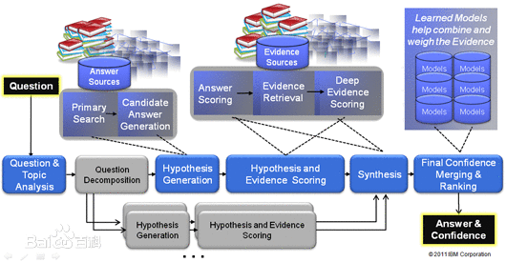
IBM Watson-Brief Architecture
Building Watson: An overview of the DeepQA project[J]
http://researcher.ibm.com/researcher/view_project.php?id=2099

Slide 45
References
AskMSR: Question Answering Using the Worldwide Web
Michele Banko, Eric Brill, Susan Dumais, Jimmy Lin
http://www.ai.mit.edu/people/jimmylin/publications/Banko-etal-AAAI02.pdf
In Proceedings of 2002 AAAI SYMPOSIUM on Mining Answers from Text and Knowledge Bases, March 2002
Web Question Answering: Is More Always Better?
Susan Dumais, Michele Banko, Eric Brill, Jimmy Lin, Andrew Ng
http://research.microsoft.com/~sdumais/SIGIR2002-QA-Submit-Conf.pdf
D. Ravichandran and E.H. Hovy. 2002. Learning Surface Patterns for a Question Answering System. ACL conference, July 2002.
Ferrucci D, Brown E, Chu-Carroll J, et al. Building Watson: An overview of the DeepQA project[J]. AI magazine, 2010, 31(3): 59-79.
The IBM DeepQA Project: http://researcher.ibm.com/researcher/view_project.php?id=2099

Slide 46
Homework
Read below paper, write a brief introduction of 1 A4 page for the paper. Your PPT should at least include (but not limited to) the motivation(动机), issues of existing work(已有文章的缺点), the methodology(方法), the results(结果) and the conclusion(结论) of the paper. Due date：
Ferrucci D, Brown E, Chu-Carroll J, et al. Building Watson: An overview of the DeepQA project[J]. AI magazine, 2010, 31(3): 59-79.

